Slide 1
Use Case: Abli
Performance Testing Whitepaper
Initial Updates (WIP)

Slide 2

About Abli:
Abli is a payment infrastructure FinTech in the Philippines. Our value proposition is ”Democratizing payments.”
USE CASE: Domestic deployment of the Mojaloop hub in the Philippines, focused on enabling inclusive instant payments at the national level.
Our goals:
Build a secure, low-cost payment rail with Mojaloop to support safe, real-time transactions at scale.
Streamline onboarding for financial institutions, fintechs, and startups to drive broader participation and adoption.
Support the Open Finance initiative to expand access to diverse financial products for individuals and enterprises.

Slide 3
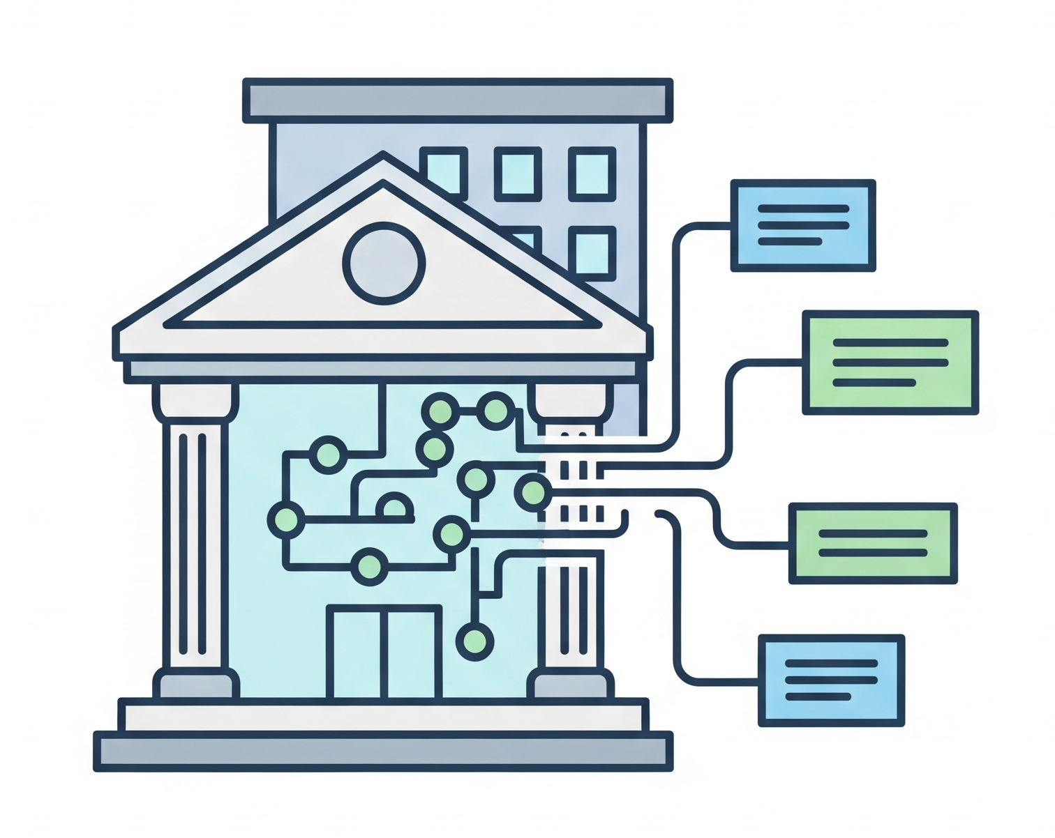
High-Level Architecture
DFSPs
IPS (MOJALOOP)
RISK/FRAUD MANAGEMENT
SETTLEMENT & RECONCILIATION
MIDDLEWARE
FINTECHS
VALUE-ADDED SERVICES (VAS)
OTHER INSTITUTIONAL PARTNERS

Slide 4
Overall Test Plan - v17
ROUND 1 SCOPE:
2 and 8 DFSPs
Static DFSP Pairing
Non-scaling
1K, 5K, 10K TPS
ROUND 2 SCOPE:
2 and 8 DFSPs
Dynamic DFSP Pairing
Autoscale
1K, 5K, 10K TPS

Slide 5
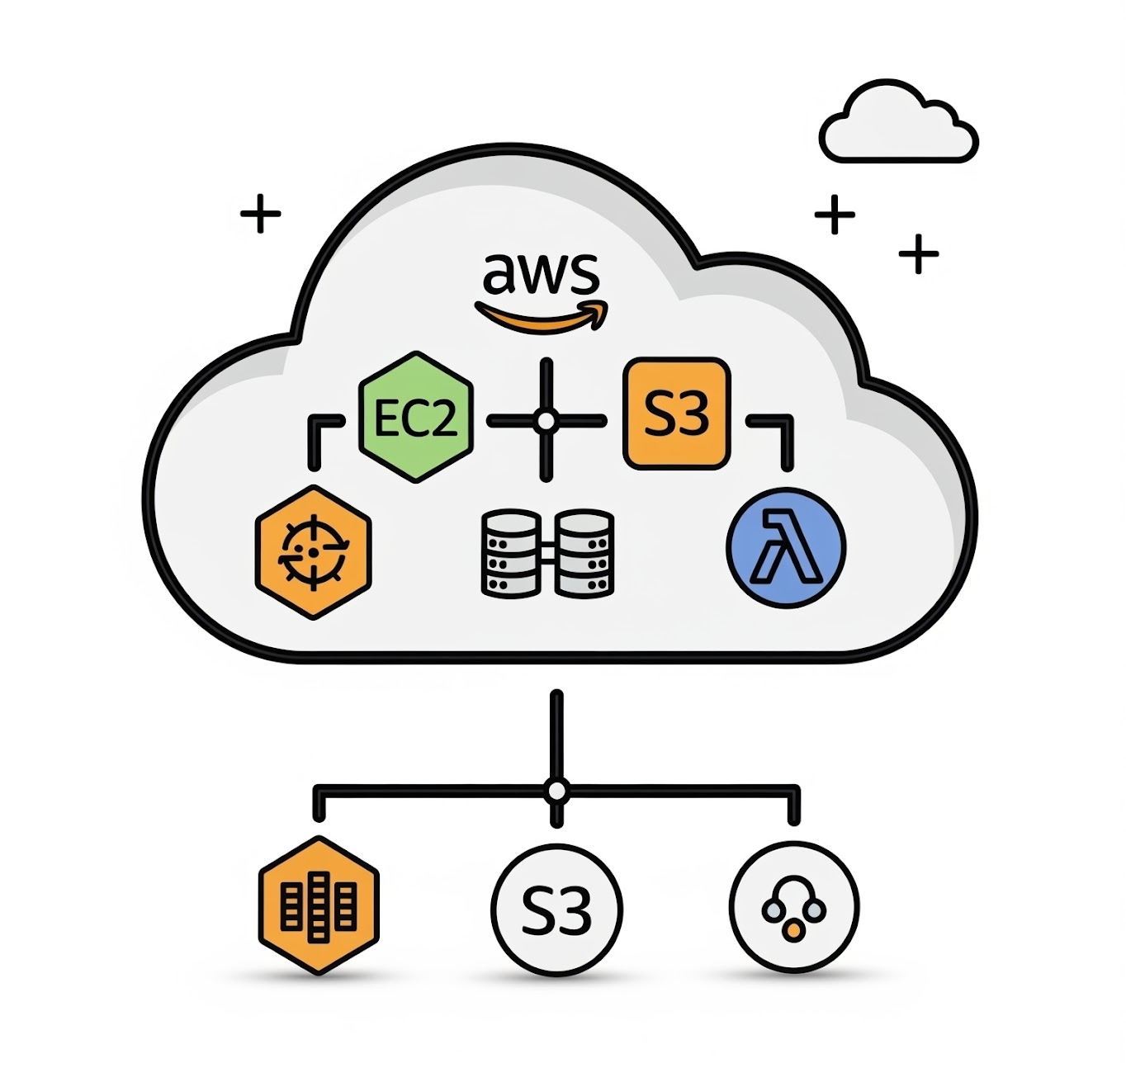
Performance Testing Config
Current Setup:
5 t3.medium EC2s for management node pool. Management nodepool includes these services:
PromStack
Kubernetes Dashboard
Cert Manager
Ingress Nginx
2 m7i.large EC2s for worker node pools dedicated to mojaloop resources only
Mojaloop Namespace includes:
8 replicas for Account Lookup Service, 5 Quoting Service, 5 ML API Adapter Service and 5 Central Ledger. Supporting handlers are scaled as well.
External AWS Services:
MSK Provisioned with 3 Broker nodes using kafka.m7g.large
Single MySQL RDS using t3.xlarge

Slide 6
Performance Testing Config
Round 1:
No HPA autoscaling applied
No assigned resource requests and limits for the pods
Deployment type
Deployed to EKS using Terraform and Helm
Test environment configuration
Number of DFSPs: 2
Settlement model: Deferred net settlement
Scope: Local transfers
Test tools
Load Testing Tool is K6 within the EKS cluster but deployed in a separate nodepool
Test scenarios
Lookup payee account
Lookup payer account
Initiate Quoting for the transfer
Perform Transfer
Notes:
Test scenario is as follow:
Lookup payee account
Lookup payer account
Initiate Quoting for the transfer
Perform Transfer

Slide 7
Initial Results
Round 1: 2 DFSPs |  | 1,000 TPS | 4,000 TPS
Performance | Transaction throughput | 999 TPS at 15mins | 3928 TPS at 15mins
 | Latency/Response time to process end-to-end payments | 55.81ms | 48.92ms
 | System availability | 100% | 100%
 | Error rate/system failure | 0% failure | 10.14% failures at NLB level not Mojaloop
 | P50 / P99 for Account Lookup Service | 14.0ms / 156ms | 12.0ms / 63.5ms
 | P50 / P99 for Central Ledger Service | 10.7ms / 24.2ms | 10.3ms / 52.2ms
 | P50 / P99 for Quoting Service | 11.1ms / 37.0ms | 10.1ms / 25.4ms
 | P50 / P99 for ML API Adapter Service | 11.1ms / 36.0ms | 11.7ms / 1.7s
 | Resource Utilization (CPU, Memory) for ALS | CPU 40% RAM 600~ MB | CPU 40% RAM 400 MB
 | Resource Utilization (CPU, Memory) for CL | CPU 40% RAM 500~ MB | CPU 40% RAM 500~ MB
 | Resource Utilization (CPU, Memory) for QS | CPU 20% RAM 400~ MB | CPU 20% RAM 400~ MB
 | Resource Utilization (CPU, Memory) for ML API | CPU 15% RAM 300~ MB | CPU 15% RAM 400~ MB
Resilience | Recovery time and recovery point | n/a | n/a

Slide 8
Next Steps
Continue testing with:
More DFSP with dynamic pairing/assignment
HPA autoscaling
Assigning resource request and limits for the pods
Potential changes
Move database to an Aurora RDS
Apply karpenter.sh
Apply Chaos Mesh

